Slide 1


HTML- Iframes,Semantic Elements
CSS- Overflow
Presented By-
Navneet
Coding Instructor
SKY Hi Tech Academy

Slide 2



JAVASCRIPT,CSS and HTML WHY WE NEED THEM?
THE BUILDER
THE ARTIST
THE MAGICIAN/WIZARD
HTML
CSS
JAVASCRIPT

Slide 3
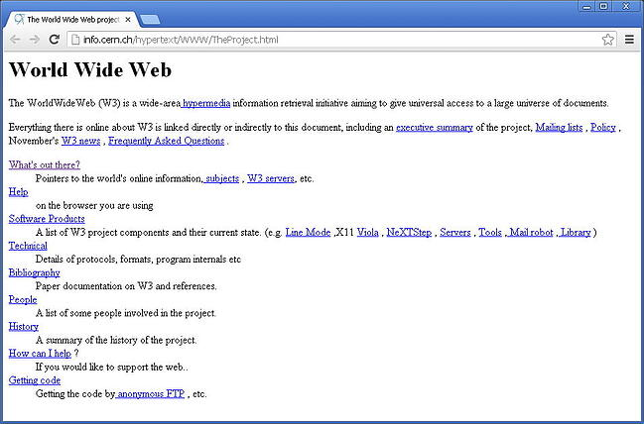
EARLIER WEB PAGES- only HTML

Slide 4
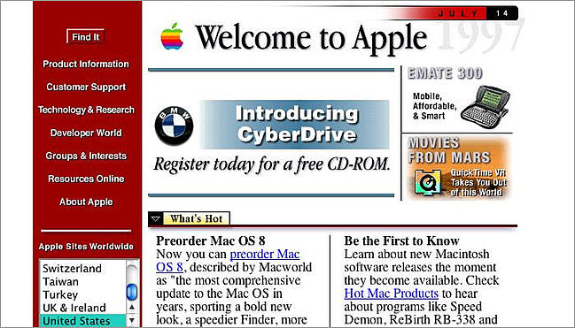
WEB PAGES- both HTML+CSS

Slide 5






What is Web Browser?
HTML
CSS
JAVASCRIPT
Renders these three languages to a visual output

Slide 6
What is IFRAME?
In HTML, <iframe> stands for inline frames.
It defines a rectangular region within the document in which the browser can display a separate document, including scrollbars and borders.
It allows you to display content from an external source within your web page.
Used to embed other documents,websites,videos, maps etc. in your current HTML document.

Slide 7

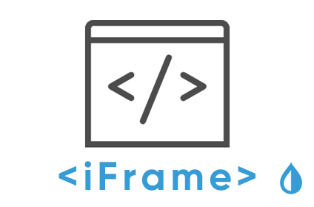




Why use IFRAME?
embed
YOUR WEBSITE

Slide 8
SYNTAX OF IFRAME
<iframe src="URL" title="description” width="value" height="value"></iframe>
Attributes:
src: The URL of the external content you want to embed in the iframe.
width: The width of the iframe.
height: The height of the iframe.
There are two types of URL links which are listed below:
Absolute URL: It points to another webpage.
Relative URL: It points to other files of the same web page.
NOTE- It is a good practice to always include a title attribute for the <iframe>. This makes the code more readable.

Slide 9
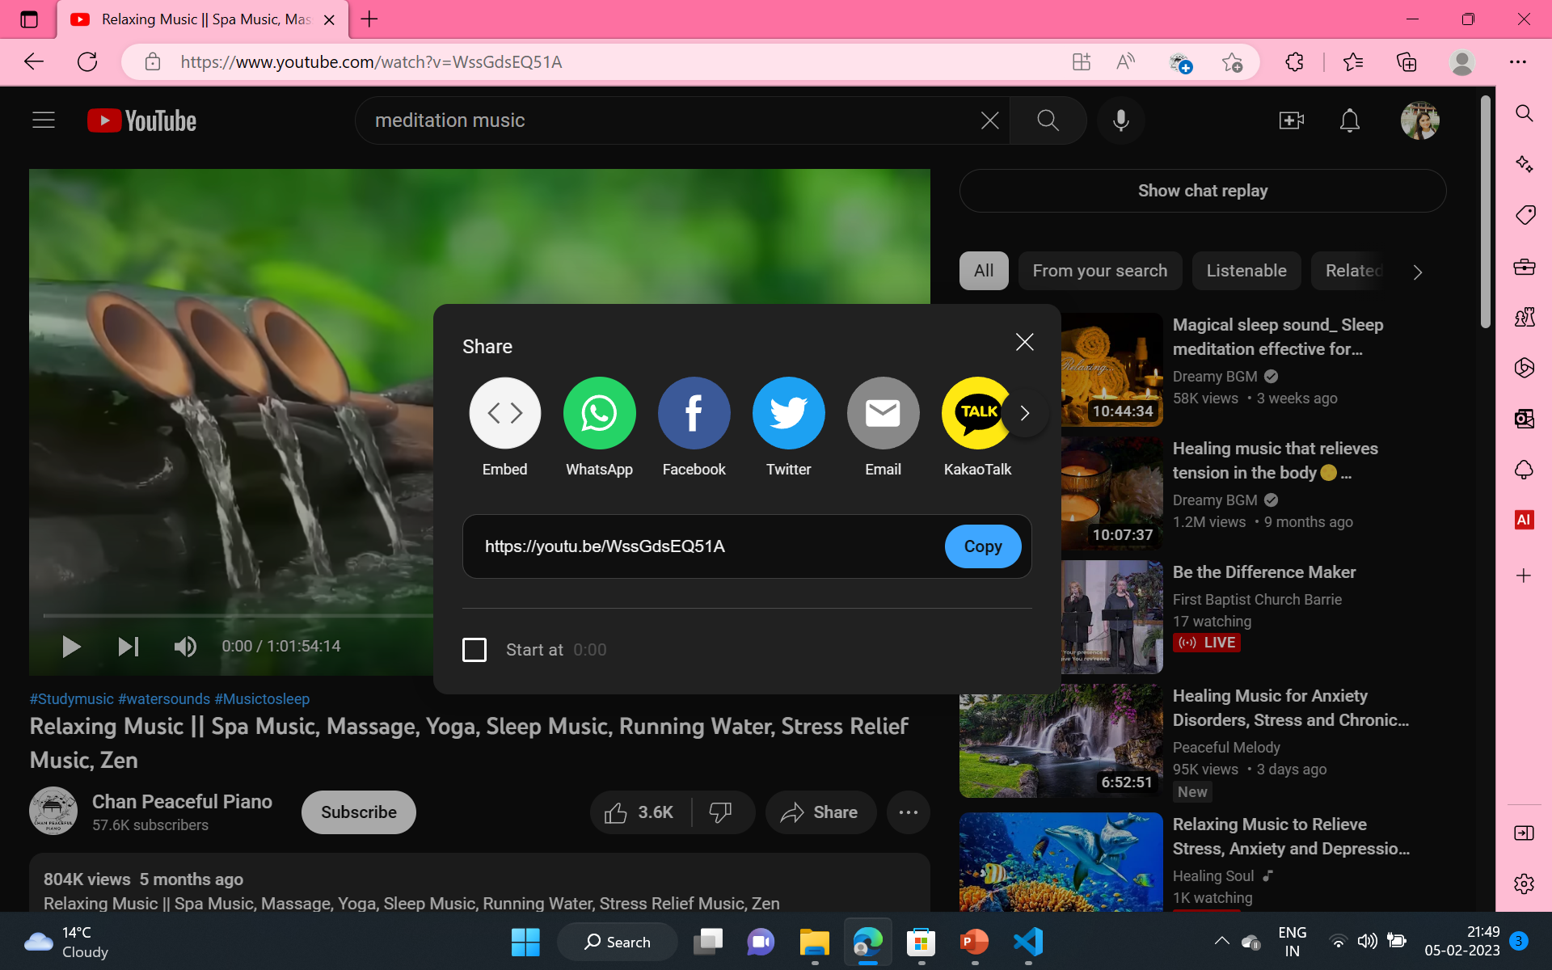
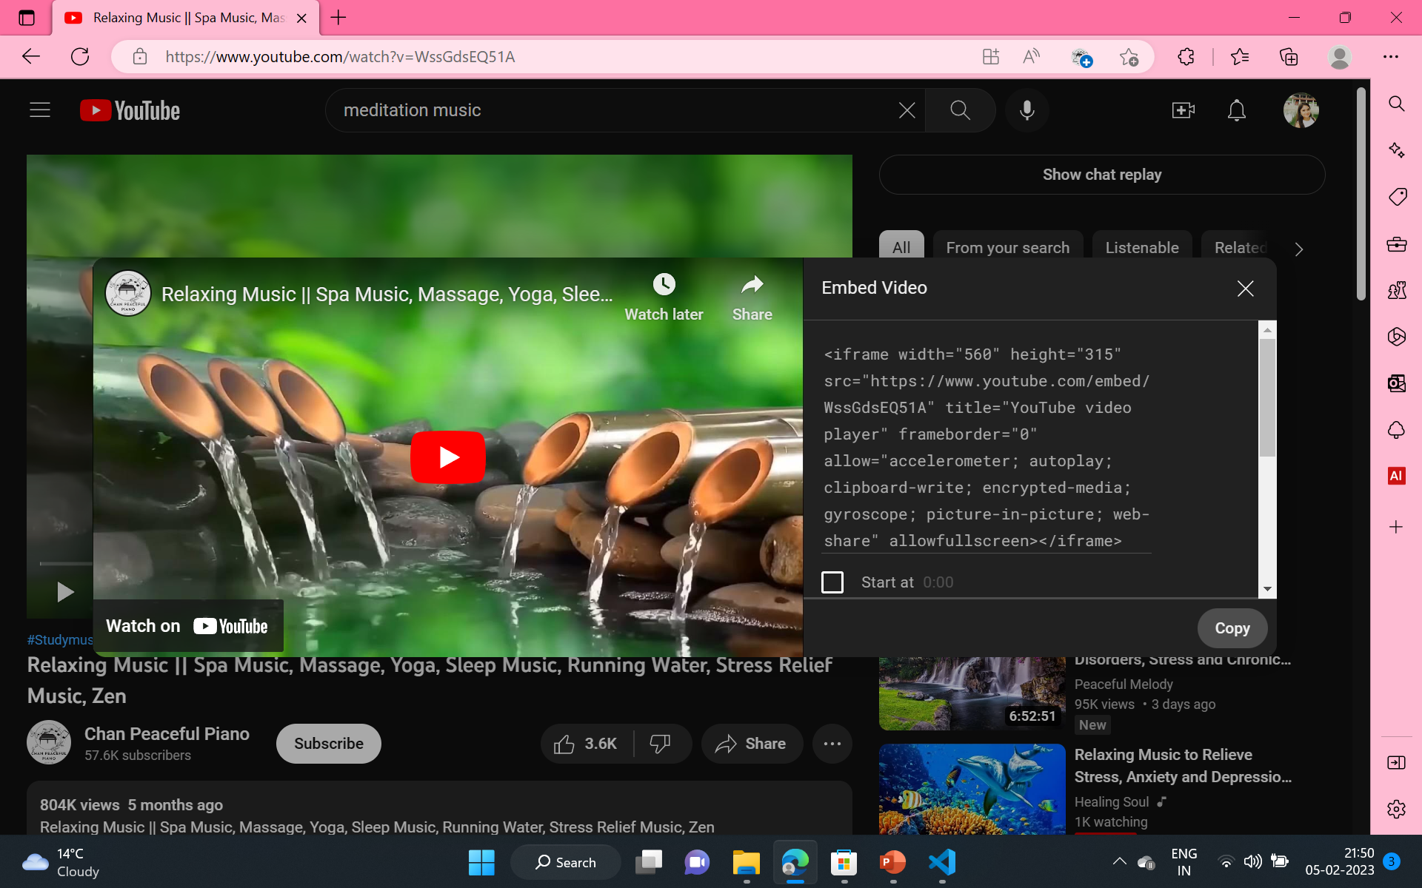



How to add Youtube Video using Iframe?
Step 2- Now click on Embed and copy the link and add this to the html file you are working on
Step 1- Click on Share below the Youtube Video

Slide 10
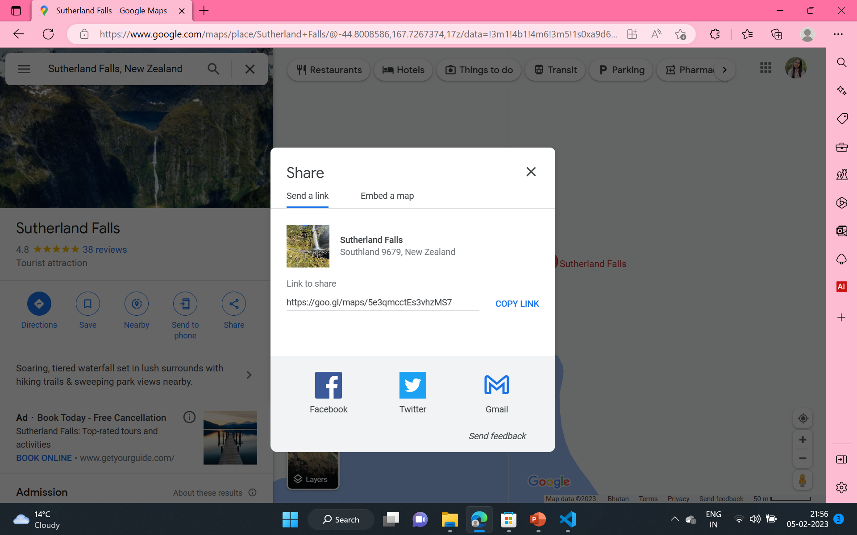
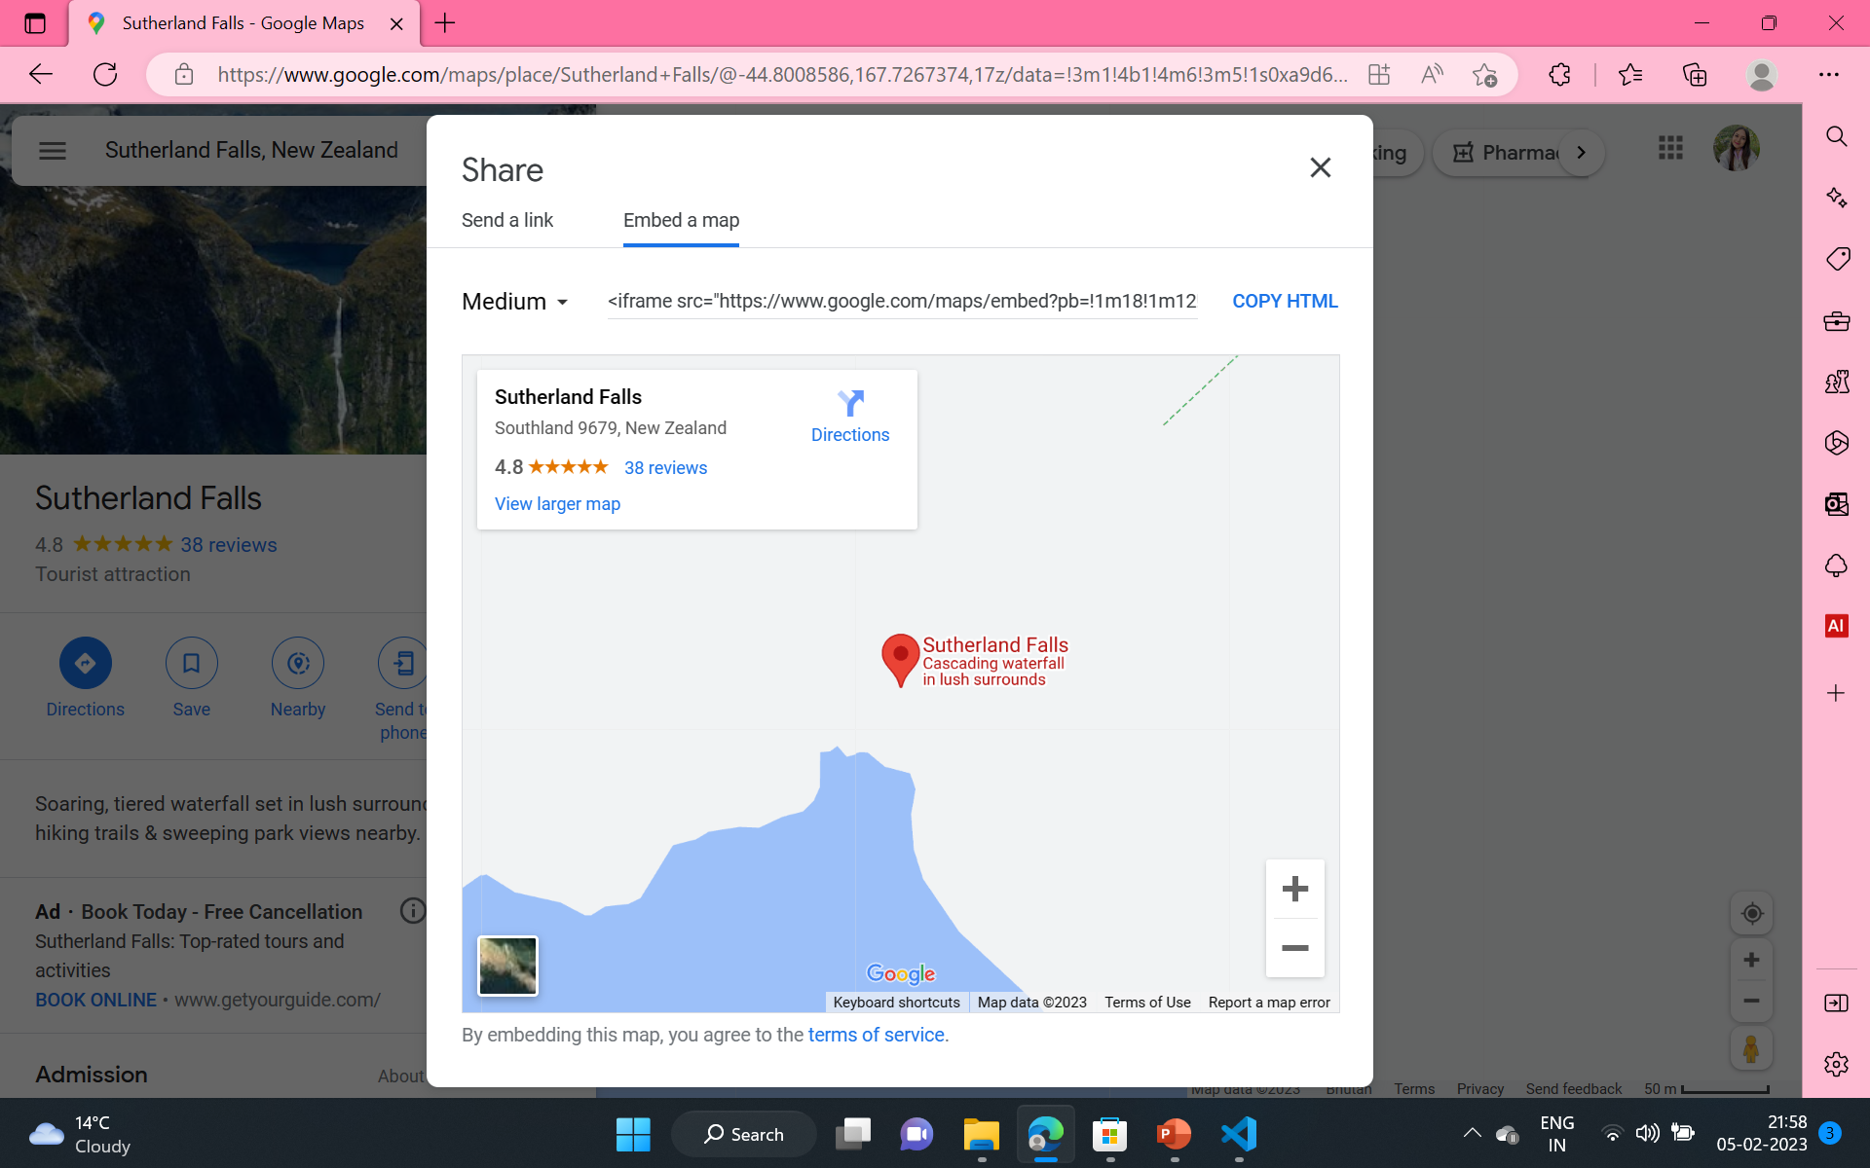


How to add Google Maps using Iframe?
Step 2- Now copy the link and just put in your html file you are working on
Step 1- Click on Share below the Place description and then click on Embed a map

Slide 11
LOADING POLICY
The "loading" policy in an iframe defines how the browser should handle the content of the iframe when it is loading. The "loading" policy can be set using the "loading" attribute in the iframe tag. For example:
<iframe loading="lazy" src="https://example.com"></iframe>
ATTRIBUTES:
"auto": The browser will load the content of the iframe immediately, as soon as the main page has finished loading.
"lazy": The browser will only load the content of the iframe when it is visible in the viewport and the user is likely to interact with it.
"eager": The browser will load the content of the iframe immediately, regardless of whether it is visible in the viewport or not.

Slide 12
REFERRER POLICY
The "referrer" policy in an iframe defines the information that is sent to the server about the page that is hosting the iframe.
This information can include the URL of the page that is hosting the iframe, which can be useful for tracking the origin of traffic and for debugging purposes.
The "referrer" policy can be set using the "referrerpolicy" attribute in the iframe tag. For example:
<iframe referrerpolicy="no-referrer" src="https://example.com"></iframe>
ATTRIBUTES:
"no-referrer": No referrer information is sent.
"no-referrer-when-downgrade": The referrer information is sent unless it would be sent to a less secure origin.
"origin": Only the origin of the page that is hosting the iframe is sent as the referrer.
"origin-when-cross-origin": The full URL of the page that is hosting the iframe is sent as the referrer when the iframe is loaded from a different origin.

Slide 13
CSS Overflow Property
The overflow property in CSS is used to specify how the content that overflows an element's box should be displayed.
It has five possible values:
visible: the content is not clipped and is visible outside of the element's box.
hidden: the content that overflows the element's box is hidden and not visible.
scroll: a scrollbar is added to the element so that the user can scroll through the content that overflows the box.
auto: a scrollbar is added only if the content overflows the box.
inherit: the value of overflow is inherited from the parent element.

Slide 14
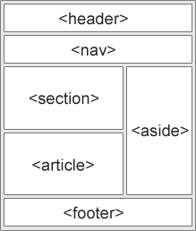
SEMANTIC ELEMENTS IN HTML
HTML semantic elements are elements that describe the meaning of the content they contain, rather than its appearance.
Using semantic elements can make your HTML code more accessible, understandable, and easier to maintain.

Slide 15
SEMANTIC vs NON-SEMANTIC
Semantic elements | Non-Semantic elements
they have meaning | they don’t have meaning
they describe how the content within them is supposed to behave | they can contain anything
they have specific attributes for their structure Ex- article, header, aside, figure | ‘class’ attribute can be used to work with their structure Ex- div, span, h1

Slide 16
SEMANTIC ELEMENTS IN HTML
TAG | PURPOSE
<header> | Represents a container for introductory content or a set of navigational links.
<nav> | Represents a section of a page that contains navigation links.
<main> | Represents the main content of a document, excluding content that is repeated across a set of documents such as headers, footers, and navigation.
<article> | Represents a self-contained composition in a document, such as a blog post, a forum post, or a news story.
<section> | Represents a standalone section of a document, such as a chapter, a tabbed content area, or a set of related content grouped together.
<aside> | Defines content aside from the page content
<footer> | Defines a footer for a document or section
<figure> | Represents a unit of content, typically an image or illustration, that is self-contained and is typically referenced as a single unit from the main flow of the document.
<figcaption> | Represents a caption for a <figure> element.
<details>: | Represents additional details that the user can view or hide.
<time> | Defines a date/time
<summary> | Defines a visible heading for a <details> element
<mark> | Defines marked/highlighted text

Slide 17
FUN FACT
A PORTRAIT MADE USING CSS
GitHub - cyanharlow/purecss-lace: HTML/CSS drawing inspired by Flemish baroque oil portraits. Hand-coded entirely in HTML & CSS.

Slide 18


